Slide 1
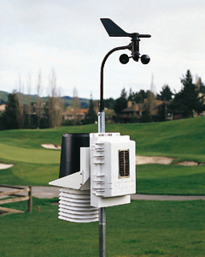
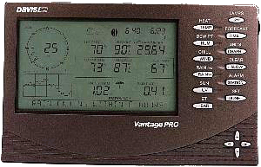
Weather Station
Perez Romain
Tsti2d 2017/2018

Slide 2
Summary
1- Presentation of the weather system
2- Presentation of the weather system France
3- Presentation of an individual weather system
4- Limitation of the study
5- Conclusion

Slide 3









1- Presentation of the weather system
Variability of weather
Meteo forecast

Slide 4
2- Presentation of the weather system France

Slide 5
3- Presentation of an individual weather system

Slide 6
4- Limitation of the study

Slide 7
Conclusion
Thank for listening !

